Slide 1
Digital Circuits and Systems Lecture 11 Microcode
Tian Sheuan Chang
傳統FSM設計後都固定寫死了，可以不用重新設計硬體，也可以有新的FSM嗎?
用state table，而且讓table可以自由變

Slide 2
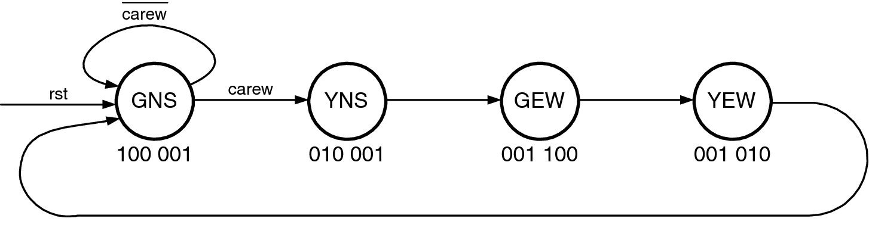
概念 [Dally. Ch. 18]
傳統FSM設計後都固定寫死了，可以不用重新設計硬體，也可以有新的FSM嗎?
State diagram
State table
讓table可以自由變

Slide 3
概念 [Dally. Ch. 18]
傳統FSM設計後都固定寫死了，可以不用重新設計硬體，也可以有新的FSM嗎?
state用table，
而且讓table可以自由變 => 程式
那next state logic or output logic
一併存成表格一部分，或
不外乎加減乘除與邏輯運算 =>那就做ALU (arithmetic logic unit)
如何做呢
Table 用RAM來做
ROM也可以
PLA也是
類似的memory型式: Flash, EEPROM
演化到後來，就是CPU了

Slide 4
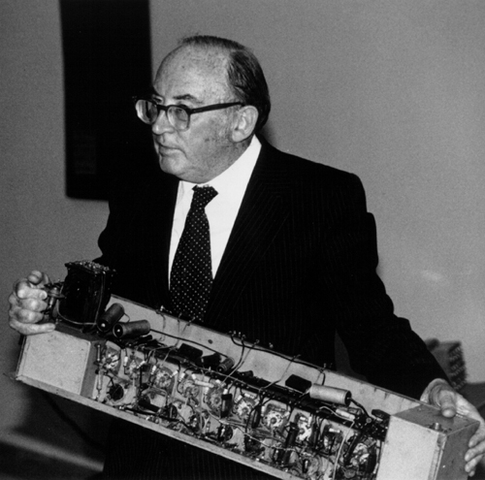
Sir Maurice Wilkes with a piece of EDSAC
Sir Maurice Vincent Wilkes,
(born June 26, 1913,
Dudley, Worcestershire,
Eng.—died Nov. 29, 2010,
Cambridge, Cambridgeshire),
British computer science
pioneer who helped build the
Electronic Delay Storage
Automatic Calculator (EDSAC),
the first full-size
stored-program computer, and
invented microprogramming.

Slide 5
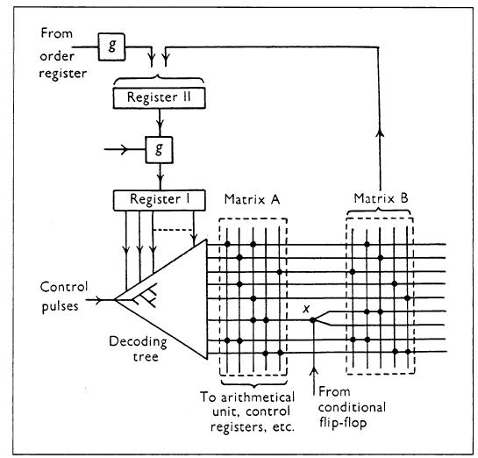
Figure from Wilkes 1953 paper on Microcode

Slide 6
Microcode – an FSM realized with a memory array
Original concept by Wilkes (1951)
Put state table in a memory (ROM or RAM)
Address: current state and input
Output (Data): next state and output
Address
Current state, input
DATA
Next state, output

Slide 7
Microcode – the picture
Memory size: 2^{s+I} (s+o) bit words;
Exponentially increases, (s+i)
Similar to combinational logic with full-addressing space
Notes:
注意大小

Slide 8
Example: Simple Light-Traffic Controller
carew
gns
carew
yns
gew
yew
100 001
010 001
001 100
001 010
state
output
gyr gyr
ns ew

Slide 9
Re-writing State Table Of Example
原來的寫法太簡化，要跟據所有state和輸入變化完全展開
State
carew
address
data
gns
00
0
000
00100001
00
1
001
01100001
yns
01
0
010
11010001
01
1
011
11010001
gew
11
0
110
10001100
11
1
111
10001100
yew
10
0
100
00001010
10
1
101
00001010

Slide 10
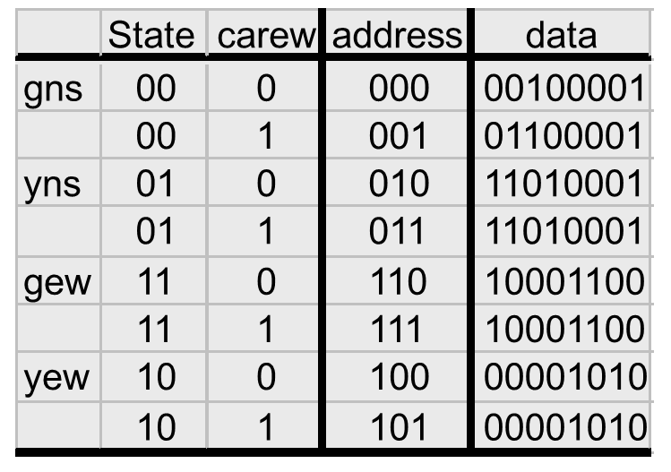
Re-writing State Table Of Example
ROM data = {next state, output}
Next
state
ROM address = {state, input}
output
注意: 要全部展開

Slide 11
Microcode Of Light-Traffic Controller
00100001
state
01100001
next
2
D
Q
2
11010001
11010001
3
10001100
8
carew
10001100
n_out
lights
00001010
D
Q
00001010
6
6
clk
當state數量和輸入變化很多造成ROM太大，有辦法縮小嗎?
Hint: 拆成兩塊，一個存next state，
一個存output。
divide into 2 ROM’s; one for state, the other for
Output; so total size = 8*2+4*6=40 (vs. 8*8=64)

Slide 12
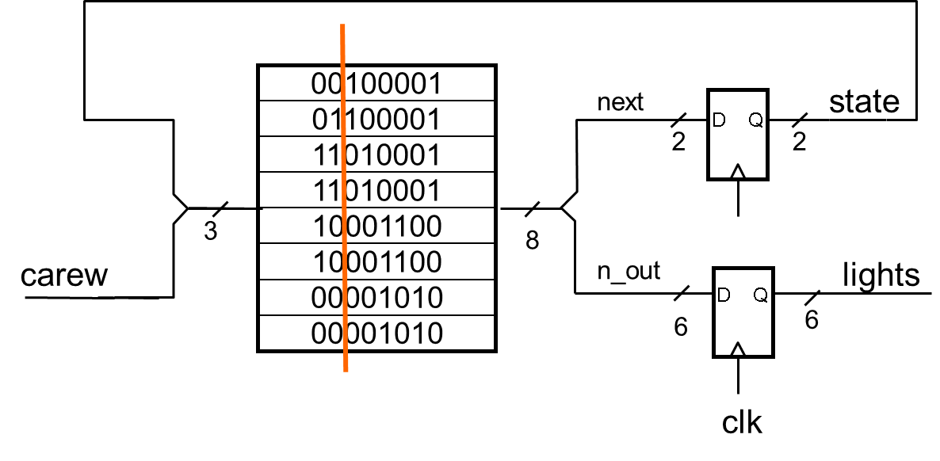
Microcoded Traffic Light Controller – in Verilog
Exercise: revise this
Controller using 2 ROM’s
module ucodeTLC(clk,rst,in,out) ;
parameter n = 1 ; // input width
parameter m = 6 ; // output width
parameter k = 2 ; // bits of state
input clk, rst ;
input [n-1:0] in ;
output [m-1:0] out ;
wire [k-1:0] next, state ;
wire [k+m-1:0] uinst ;
DFF #(k) state_reg(clk, next, state) ; // state register
DFF #(m) out_reg(clk, uinst[m-1:0], out) ; // output register
ROM #(n+k,m+k) uc({state, in}, uinst) ; // microcode store
assign next = rst ? {k{1'b0}} : uinst[m+k-1:m] ; // reset state
endmodule

Slide 13
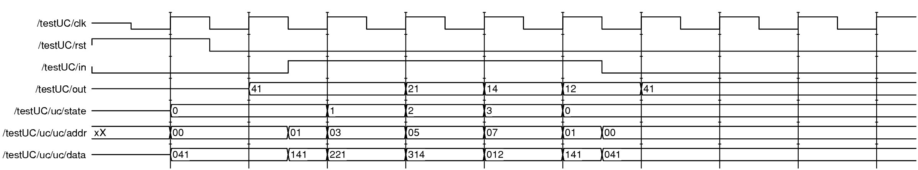
Waveforms Of Light-Traffic Controller Microcode
carew
00_100_001
01_100_001
10_010_001
10_010_001
11_001_100
11_001_100
00_001_010
00_001_010
Next state
Output (rgb, rgb)
Notes:
/uc/data 為配合原來state, out (rgb, rgb), 值，顯示時分成三部分 00_100_001 => 0000 0100 0001

Slide 14
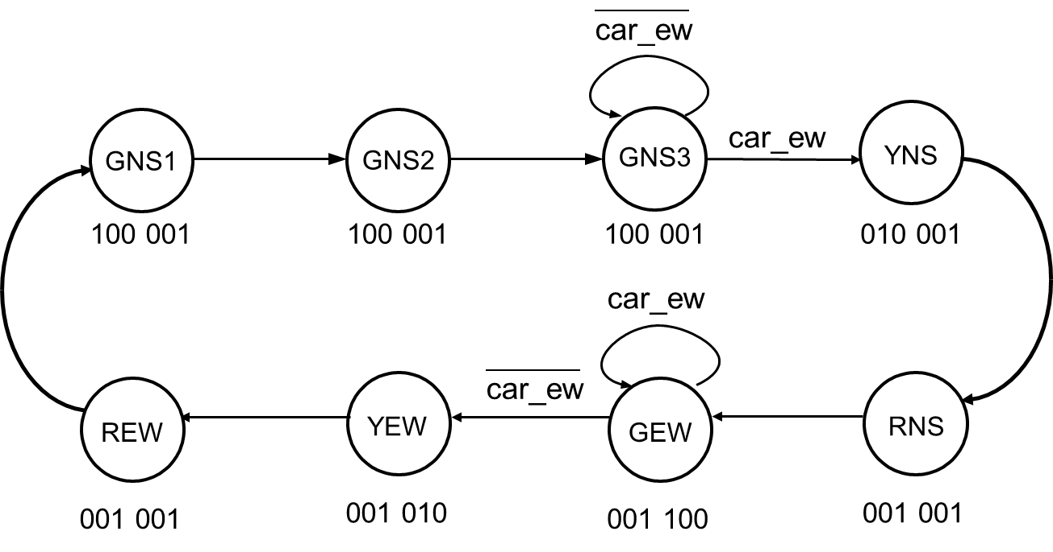
A New-and-Improved Light-Traffic Controller
不改設計，改state table，創造新的FSM
Additional functions to original Light-Traffic Controller:
Light stays green in eat-west direction as long as car_ew is true.
Light stays green in north-south direction for a minimum of 3 states (GNS1, GNS2, and GNS3).
After a yellow light, lights should go red in both directions for 1 cycle before turning new light green.

Slide 15
Light-Traffic Control State Diagram
car_ew
car_ew
GNS1
GNS2
GNS3
YNS
100 001
100 001
100 001
010 001
car_ew
car_ew
REW
YEW
GEW
RNS
001 001
001 010
001 100
001 001

Slide 16
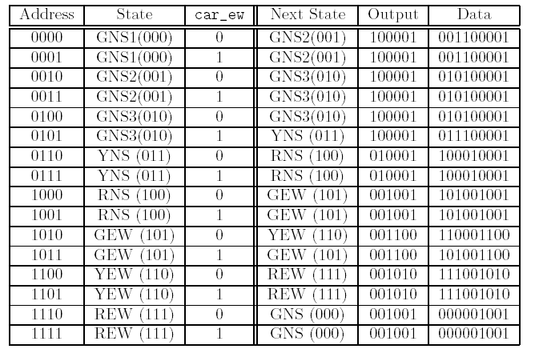
Light-Traffic Controller State Microcode
不改設計，改state table，創造新的FSM
ROM address = {state, input}
ROM data = {next state, output}

Slide 17

Waveforms Of Light-Traffic Controller Microcode
001100001
001100001
010100001
010100001
010100001
011100001
100010001
100010001
101001001
101001001
110001100
101001100
111001010
111001010
000001001
000001001

Slide 18
From FSM table to instruction sequencing 邁向CPU設計之路

Slide 19
簡單ROM based table
缺點: 面積大
尤其輸入很多的時候，指數型增加
觀察
大部分時間next state 都單純指向下一個state
不管輸入是0 或 1，和輸入沒半點關係
少數需要branch到新的state
作法
用一個microprogram counter (μPC) register紀錄
接下來的state順序 (state sequencing)
大部分時間就像counter，直接加一
少部分時間load新值，branch到較遠的state
=>可以用程式控制=>microprogramming =>CPU 設計
Next state
output
ROM address = {state, input}
ROM data = {next state, output}

Slide 20
Instruction Sequencing
With lot of inputs, size of memory increases rapidly (exponentially).
Can reduce memory size by observing:
Most of the time we move to the next state.
We usually only need to branch to one other state based one (or a few) inputs.
Add a microprogram counter (μPC) register to simplify state sequencing.

Slide 21
Instruction Sequencing – the picture
s
D
Q
branch_target
+1
0
Mux3
s
s
1
nuPC
D
Q
uPC
a
Memory
d
s
s
s
s+o+b
0
2
s
n_out
out
3
o
D
Q
o
inputs
i
Branch
clk
Logic
branch_instruction
b
大部分時間就像counter，直接加一
少部分時間load新值，branch到較遠的state
Notes:
ROM address = {state, input}
ROM data = {next state, output}

Slide 22
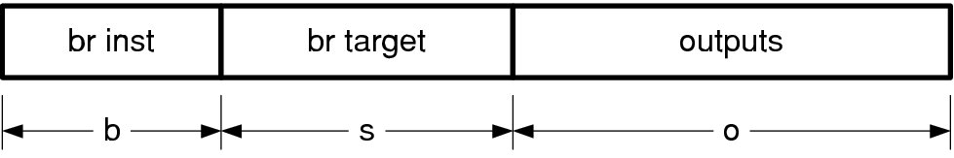
Branching Logic
Branch logic selects between μPC+1 and branch_target, depending on input and branch_instruction.
Instructions are of the form branch if f(inputs)
For example branch if car_ew or branch if not car_ew.

Slide 23
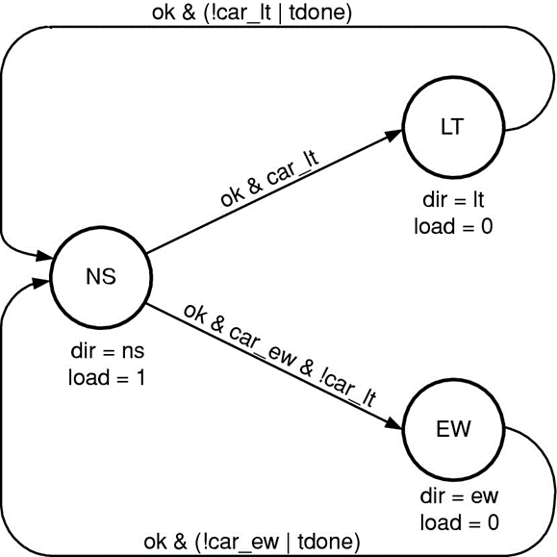
Branch Microinstructions
Define several instructions for traffic light control:
Opcode | Encoding | Description
NOP | 000 | No branch – always go to next instruction
br | 100 | Always branch
brlt | 001 | Branch when left-turn car is detected
brnlt | 101 | Branch if no left-turn car is detected
brew | 010 | Branch when east-west car is detected
brnew | 110 | Branch if no east-west car is dected
用之前有left turn的例子
只考慮車況
branch = (brinst[0] & in[0] | brinst[1] & in[1]) ^ brinst[2] ;
Brinst[2]: decide to branch or not
Brinst[1]: east-west car
Brinst[0]: left-turn car
Other encodings are possible
Notes:
Brinst[2]: decide to branch or not
Brinst[1]: east-west car
Brinst[0]: left-turn car
Branch instruction bits 0 and 1 select whether we test input bits 0 or 1 (or
either). Branch instruction bit 2 controls the polarity of the test. If brinst[2]
is low, we branch if the selected bit(s) is high. Otherwise we branch if the
selected bit(s) is low. Using this encoding of the branch instruction, we can
perform the branches shown in Table 18.3.

Slide 24

Microcode Of Traffic-Light Controller With Branches
State
Addr
Inst
Target
Output
nsg1
0000
brlt
lt1
100001001
green ns
3-way
nsg2
0001
brnew
nsg1
100001001
green ns
ew1
0010
nop
010001001
yellow ns
ew2
0011
brew
ew2
001001100
green ew
ew3
0100
br
nsg1
001001010
yellow ew
lt1
0101
nop
010001001
yellow ns
lt2
0110
brlt
lt2
001100001
green lt
lt3
0111
br
nsg1
001010001
yellow lt
3-way: 因為每個branch只能跳往一個方向(預設往下一個)，3-way要
用2個state (NS1,NS2) (預設往下執行)
Ex. 開始nsg1: if lt==true, brlt, else next inst: nsg2
nsg2: brnew: no ew. If no ew == true, branch to self, nsg1, else next instr: ew1
每個state預設繞回自己有畫出來
Notes:
Because the microcoded FSM of Figure 18.6 can only branch one way in
each microinstruction, it takes two states (NS1 and NS2) to perform a three
way branch between staying with north-south, going to east-west, or going to
left-turn. This results in two states with the lights green in the north-south
direction (NS1 and NS2) and two states with the lights yellow in the north-south
direction (EW1 and LT1). The real solution to this problem is to support a
multi-way branch (which we will discuss below). However we can partially solve
the problem in software by using the alternate microcode shown in Table 18.6.

Slide 25
Microcode Of Traffic-Light Controller With Branches
State
Addr
Inst
Target
Output
nsg1
0000
brlt
lt1
100001001
green ns
nsg2
0001
brnew
nsg1
100001001
green ns
ew1
0010
nop
010001001
yellow ns
ew2
0011
brew
ew2
001001100
green ew
LT true
ew3
0100
br
nsg1
001001010
yellow ew
lt1
0101
nop
010001001
yellow ns
lt2
0110
brlt
lt2
001100001
green lt
lt3
0111
br
nsg1
001010001
yellow lt
每個state預設繞回自己有畫出來
Notes:
Because the microcoded FSM of Figure 18.6 can only branch one way in
each microinstruction, it takes two states (NS1 and NS2) to perform a three
way branch between staying with north-south, going to east-west, or going to
left-turn. This results in two states with the lights green in the north-south
direction (NS1 and NS2) and two states with the lights yellow in the north-south
direction (EW1 and LT1). The real solution to this problem is to support a
multi-way branch (which we will discuss below). However we can partially solve
the problem in software by using the alternate microcode shown in Table 18.6.

Slide 26
Microinstruction Format
For our example:
b = 3
s = 4
o = 9

Slide 27
Implementing Microcode Of Light-Traffic Controller With Branches Using Verilog
module ucodeIS(clk,rst,in,out) ;
parameter n = 2 ; // input width
parameter m = 9 ; // output width
parameter k = 4 ; // bits of state
parameter j = 3 ; // bits of instruction
input clk, rst ;
input [n-1:0] in ;
output [m-1:0] out ;
wire [k-1:0] nupc, upc ; // microprogram counter
wire [j+k+m-1:0] uinst ; // microinstruction word
// split off fields of microinstruction
wire [m-1:0] nxt_out ; // = uinst[m-1:0] ;
wire [k-1:0] br_upc ; // = uinst[m+k-1:m] ;
wire [j-1:0] brinst ; // = uinst[m+j+k-1:m+k] ;
assign {brinst, br_upc, nxt_out} = uinst ;
DFF #(k) upc_reg(clk, nupc, upc) ; // microprogram counter
DFF #(m) out_reg(clk, nxt_out, out) ; // output register
ROM #(k,m+k+j) uc(upc, uinst) ; // microcode store
// branch instruction decode; branch to new or next (+1) address
wire branch = (brinst[0] & in[0] | brinst[1] & in[1]) ^ brinst[2] ;
// sequencer
assign nupc = rst ? {k{1'b0}} : branch ? br_upc : upc + 1'b1 ;
endmodule
Ref. L5 SystemVerilog
p. 35-37

Slide 28
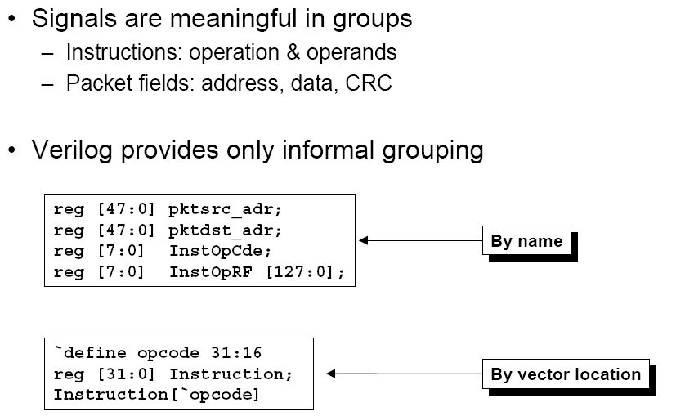
Data Organization

Slide 29
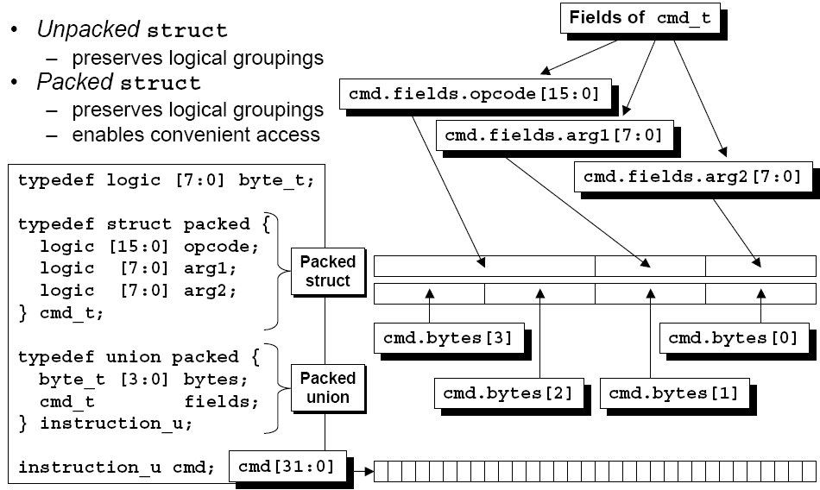
Data Organization – Packed Structs & Packed Unions

Slide 30
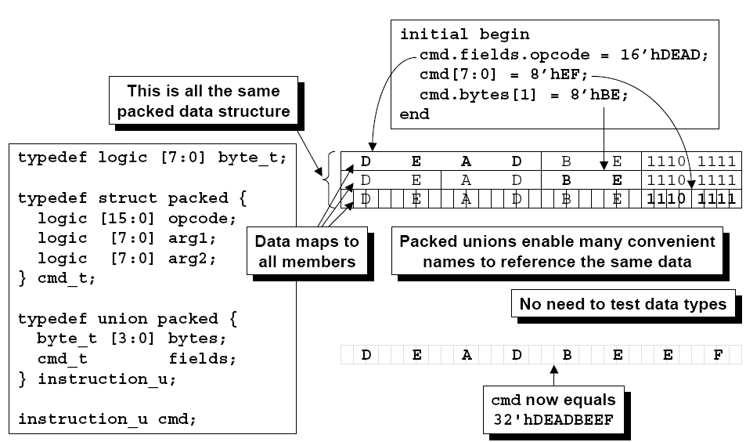
Data Organization – Packed Structs & Packed Unions

Slide 31
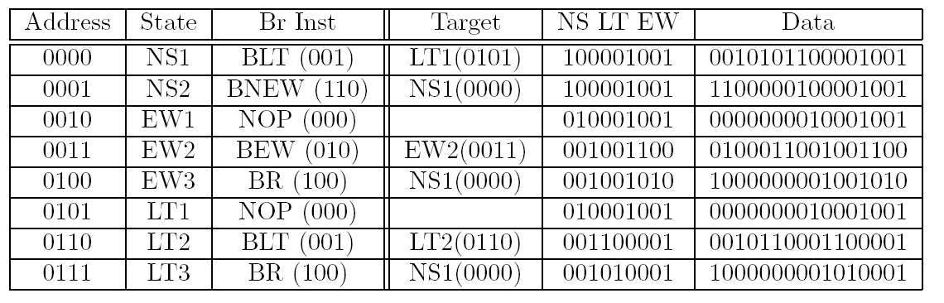
Microcode Of Light-Traffic Controller With Left Turn
Traffic
light
Data = {instruction_code, branch address, light_control}

Slide 32
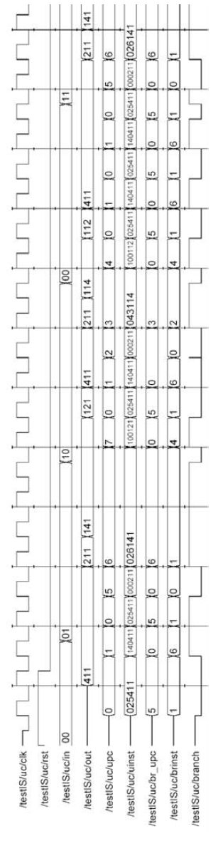
Waveforms Of Light-Traffic Controller With Left Turn Microcode
0010101100001001
1100000100001001
0000000010001001
0100011001001100
1000000001001010
0000000010001001
0010110001100001
1000000001010001

Slide 33
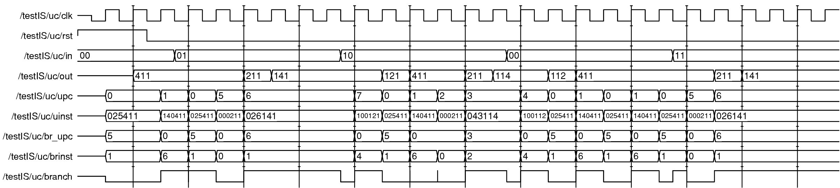
Waveforms Of Light-Traffic Controller With Left Turn Microcode
0010101100001001
1100000100001001
0000000010001001
0100011001001100
1000000001001010
0000000010001001
0010110001100001
1000000001010001
Notes:
p. 393

Slide 34
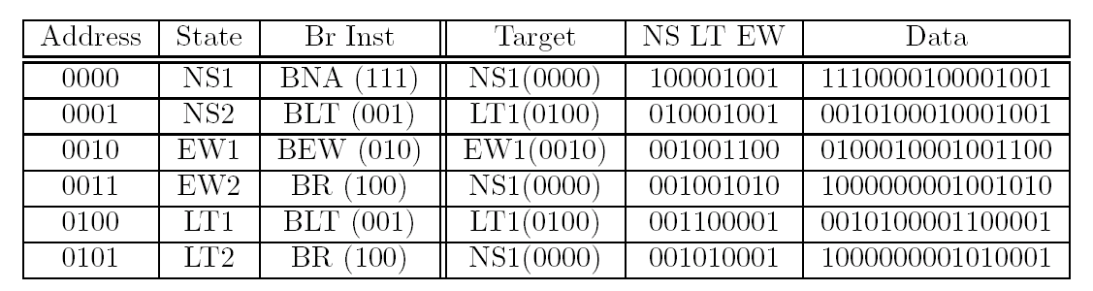
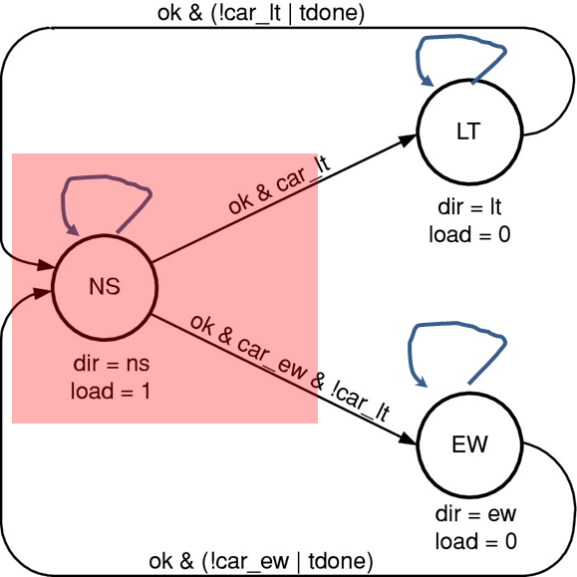
Alternate Microcode For Light-Traffic Controller With Left Turn (多方向branch指令)
BNA: branch on not any input is true
Previous microcode needs:(due to only branch one way in one instruct)
2 states with GNS light (NS1 & NS2)
2 states with YNS light (EW1 & LT1)
By adding a new branch instruction – BNA (branch on “not any”)
1 state with GNS light (NS1)
1 state with YNS light (NS2)
BNA: 沒有任意輸入條件為true，才跳
Notes:
Original branch has at most two next states (upc+1) and br _upc. This could be a problem for a large number of exit.
p. 394
One solution:
multi-way branch
In the alternate microcode of Table 18.6, the uPC stays in state NS1 as long
as car_ew and car_lt are both false by using a BNA NS1 (branch on not any
inputs to NS1). NS1 is now the only state with the lights green in the northsouth
direction. If any inputs are true, the uPC proceeds to state NS2 which is
the single state with the lights yellow in the north-south direction. State NS2
tests the car_lt input and branches to state LT1 if true (BLT LT1). If car_lt
is false, the uPC proceeds to EW1. The remainder of the machine is similar to
that of Table 18.5 except that the EW and LT states have been renumbered.

Slide 35
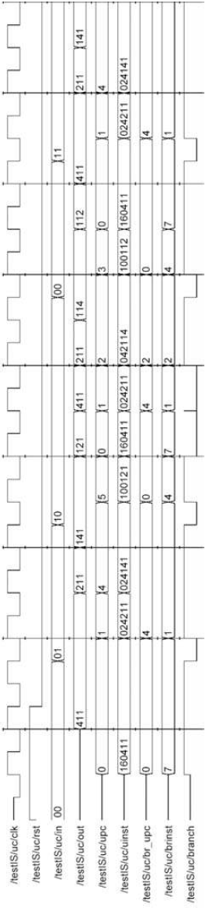
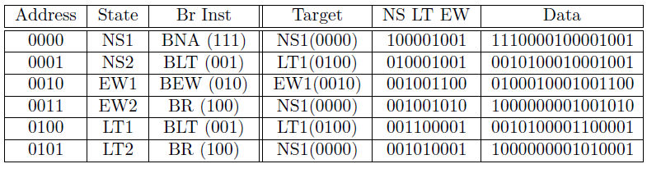
Waveforms Of Alternate Microcode

Slide 36
Multiple Instruction Types (指令可以縮短嗎)
For some FSMs the micro-instruction word can start getting a bit long.
要跳的位址很遠的話，指令會變很長
To shorten it, we observe:
Not every state needs a branch
Not every output changes on every state
Define instruction that does just a branch or a load of one register:
brx – 1yyyvvvv - branch to value vvvv on condition yyy
ldx - 0yyyvvvv - load register yyy with value vvvv
Notes:
專門設計一個branch用的指令
Ldx 還要搭配brx，需要兩個指令
Brx 省了output field
Ldx 省了target

Slide 37
Instruction Format Of Microcode With 2 Instruction Types (一次用一種)
Branch Instructions:
Operates branch mux as before
No write to output registers
Load Instructions:
Sets branch mux to +1
Update selected output register:
Can include other datapath components – e.g., timer in place of an output register
Branch Instruction
Load Instruction
1
condition
branch target
0
destination
value
1
3
4
1
3
4

Slide 38
One step on the path to a processor 邁向CPU設計之路
State table → Branch Inst → Branch and Load Insts → Full Instruction Set

Slide 39
Block Diagram Of Microcode With Output Instructions
//reduce instruction space with brx or ldx

Slide 40
Microcode For Traffic-Light Controller With brx & ldx Instructions
Registers to load:
ldns – load north/south light with value
ldlt – load left-turn light with value
ldew – load east/west light with value
ltim1 – load timer 1 with value – starts timer
??: 有沒有覺得哪裡怪怪的?每個register load 值都要一個指令

Slide 41

Microcode For Traffic-Light Controller With brx & ldx Instructions (Cont)
EW to
Red
NS
Green
Back to NS
Until input
Wait for NS Red,
make LT
Green
NS
Yellow
to Red
EW or LT?
Wait for NS Red,
make EW
Green
LT to
Red
Back to NS
bntz: branch if not timer zero
brnle: branch if no left or EW input
Notes:
Table 18.9 p.400
bntz: branch if not timer zero
brnle: branch if no left or EW input

Slide 42
Implementing Traffic-Light Controller Microcode With brx & ldx Instructions In Verilog
//----------------------------------------------------------------------
module ucodeMI(clk,rst,in,out) ;
parameter n = 2 ; // input width
parameter m = 9 ; // output width
parameter o = 3 ; // output sub-width
parameter k = 5 ; // bits of state
parameter j = 4 ; // bits of instruction
input clk, rst ;
input [n-1:0] in ;
output [m-1:0] out ;
wire [k-1:0] nupc, upc ; // microprogram counter
wire [j+k-1:0] uinst ; // microinstruction word
wire done ; // timer done signal
// split off fields of microinstruction
wire opcode ; // opcode bit
wire [j-2:0] inst ; // condition for branch, dest for store
wire [k-1:0] value ; // target for branch, value for store
assign {opcode, inst, value} = uinst ;
To be continued on next page…

Slide 43
Implementing Traffic-Light Controller Microcode With brx & ldx Instructions In Verilog (Cont)
DFF #(k) upc_reg(clk, nupc, upc) ; // microprogram counter
ROM #(k,k+j) uc(upc, uinst) ; // microcode store
// output registers and timer
DFFE #(o) or0(clk, e[0], value[o-1:0], out[o-1:0]) ; // NS
DFFE #(o) or1(clk, e[1], value[o-1:0], out[2*o-1:o]) ; // EW
DFFE #(o) or2(clk, e[2], value[o-1:0], out[3*o-1:2*o]) ; // LT
Timer #(k) tim(clk, rst, e[3], value, done) ; // timer
// enable for output registers and timer
wire [3:0] e = opcode ? 4'b0 : 1<<inst ;
// branch instruction decode
wire branch = opcode ? (inst[2] ^ (((inst[1:0] == 0) & in[0]) | // BLT
((inst[1:0] == 1) & in[1]) | // BEW
((inst[1:0] == 2) & (in[0]|in[1])) | //BLE
((inst[1:0] == 3) & done))) // BTD
: 1'b0 ; // for a store opcode
// microprogram counter
assign nupc = rst ? {k{1'b0}} : branch ? value : upc + 1'b1 ;
endmodule

Slide 44
Extending this to a processor
Add three new instructions //like RISC
ADD //add data and keep the result in registers
R2 <- R1+R0
LOAD //load data from memory
R2 <- M[R1+R0]
STORE //store data back to memory
M[R1+R0] <- R2
And add registers R0, R1, R2 – can also target these with LDR
Opcode 000/Branch, 001/LDR, 010/ADD, 011/LOAD, 100/STORE
Branch and LDR take condition/register and value fields
ADD, LOAD, STORE ignore these fields
Can tweak the instruction set to make this more efficient.
-> more details about RISC design, refer computer organization and architecture.

Slide 45
Summary
Microcode is just FSM implemented with a ROM or RAM
One address for each state x input combination
Address contains next state and output
Adding a sequencer reduces size of ROM/RAM
One entry per state rather than 2^{i}
uPC, incrementer, branch address, and branch control
Adding instruction types reduces width of ROM/RAM
Branch or output in each instruction – rather than both
Type field specifies which one
One step away from a full processor
Just add more instructions

